Slide 1
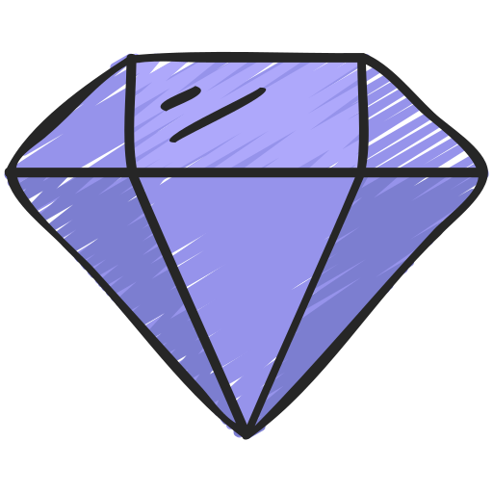
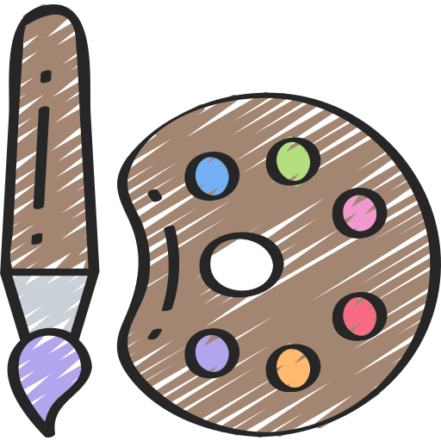
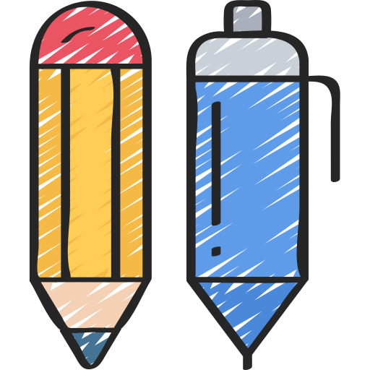
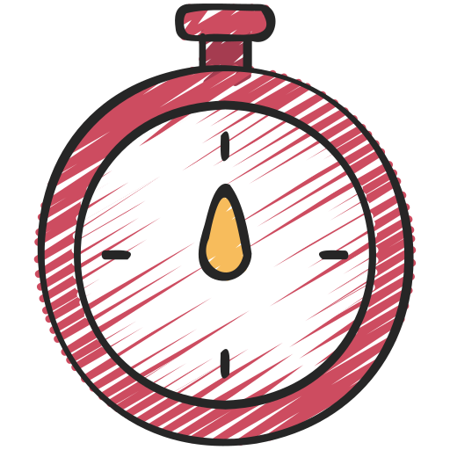
Get yourselves into teams of no more than 4
Grab a pen and paper to record your answers
Try and be discreet – don’t shout out the answers!
Get involved and have fun!

Slide 2
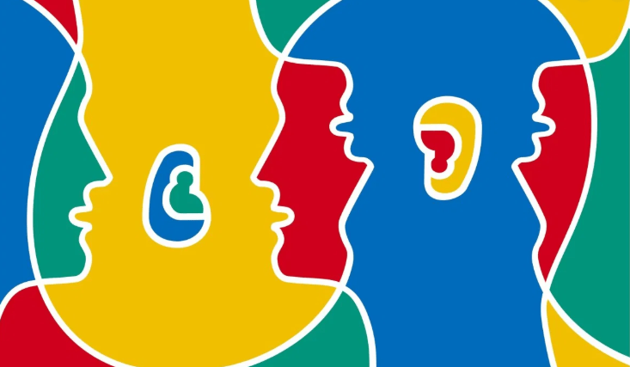
On what date is European Day of Languages celebrated?
A) 26th September
B) 27th September
C) 28th September
C) 29th September
Notes:
A

Slide 3
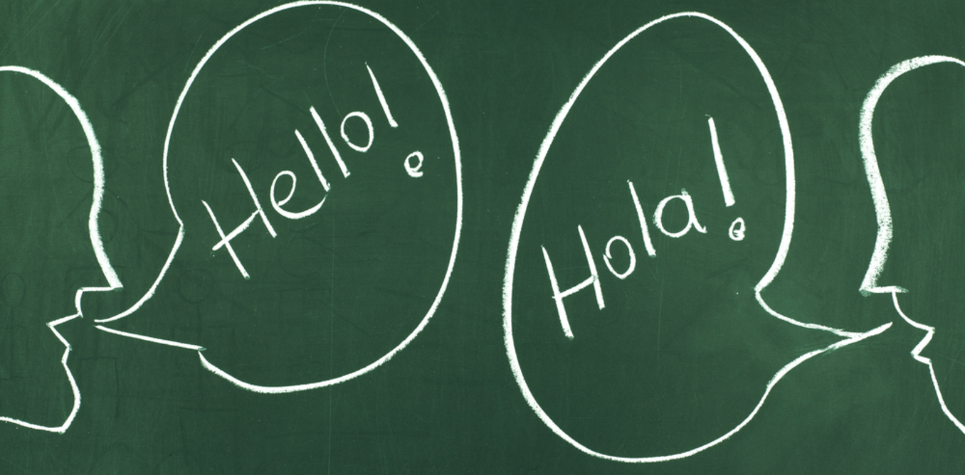
Less than half of Europe is Bilingual
A) True
B) False
Notes:
B

Slide 4
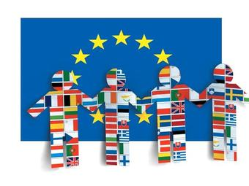
When was European Day of Languages first celebrated?
A) 2000
B) 2001
C) 2002
D) 2020
Notes:
B

Slide 5
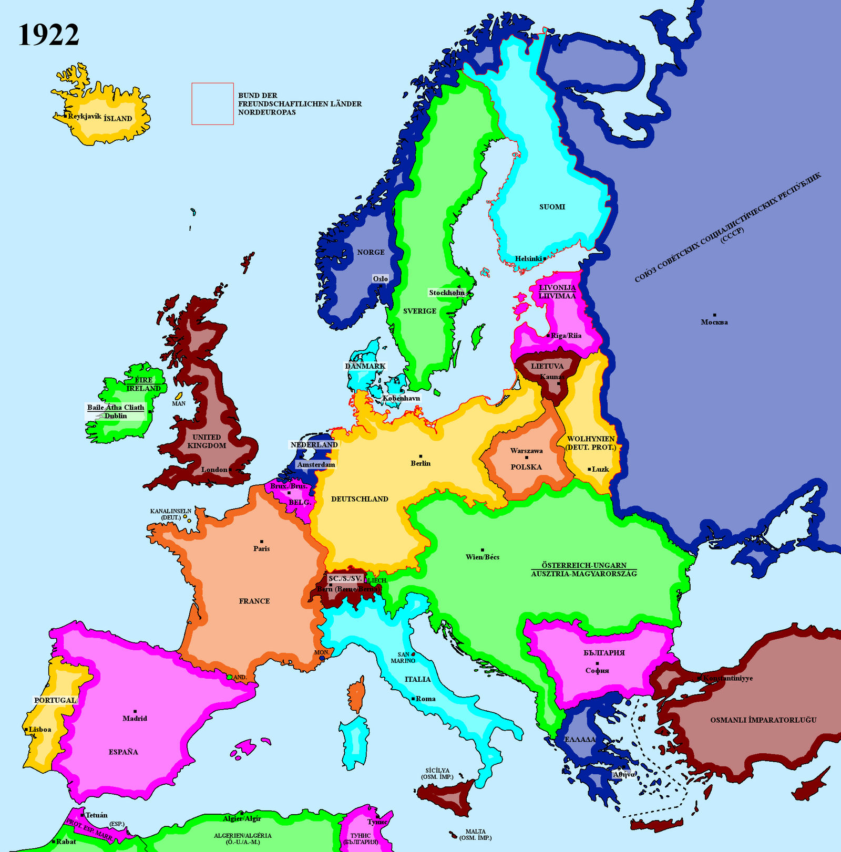
How many member states are there in Europe?
A) 43
B) 44
C) 45
D) 46
Notes:
D

Slide 6
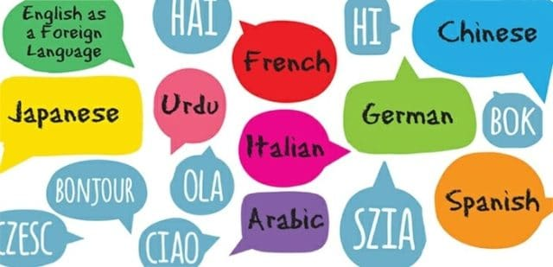
How many different languages are spoken across the world today?
A) 1000 - 2000
B) 3000 - 4000
C) 5000 - 6000
D) 6000 - 7000
Notes:
D

Slide 7
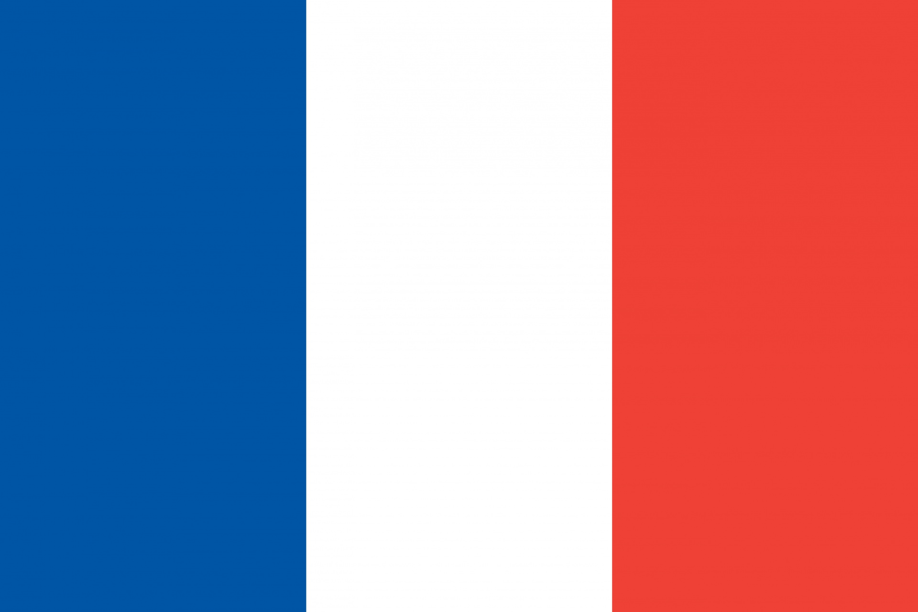
French was the official language of England for over 300 years
A) True
B) False
Notes:
A

Slide 8
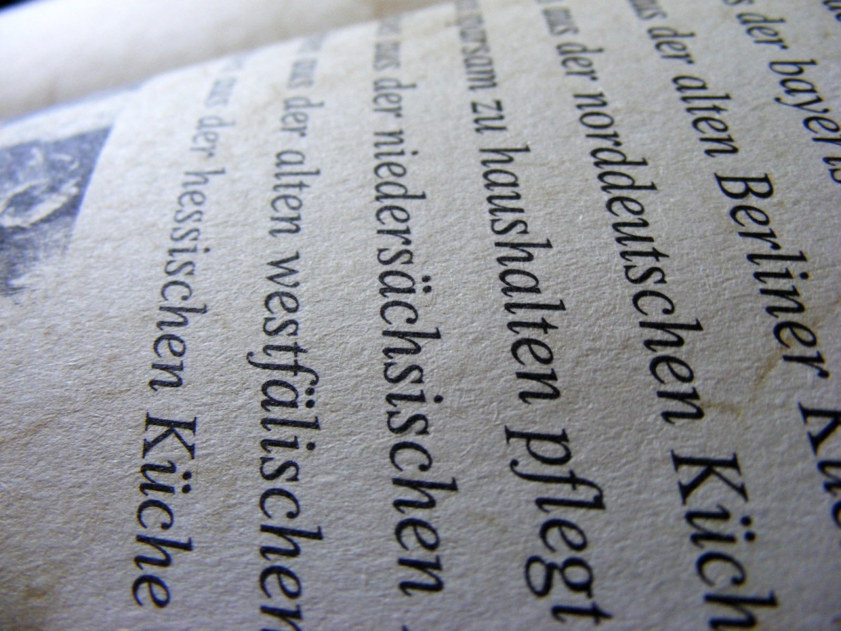
What is the oldest European language?
A) French
B) Greek
C) Basque
D) Gaelic
Notes:
C

Slide 9
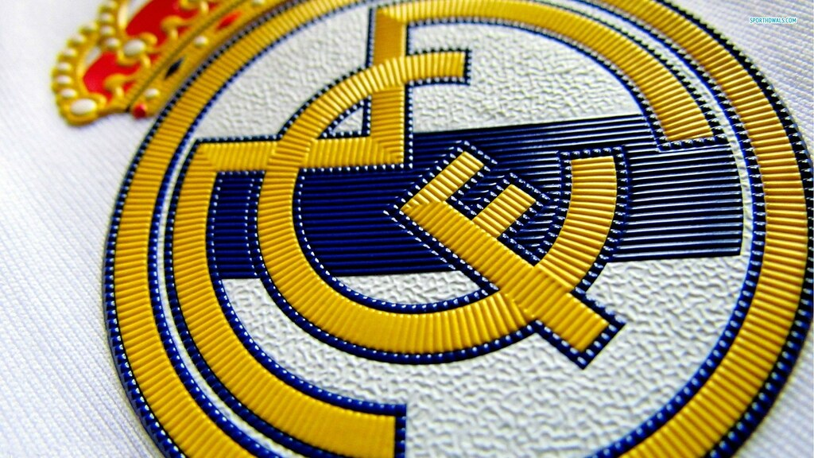
What does ‘Real’ mean in Real Madrid?
A) Real
B) Regal
C) Winner
D) Royal
Notes:
D

Slide 10
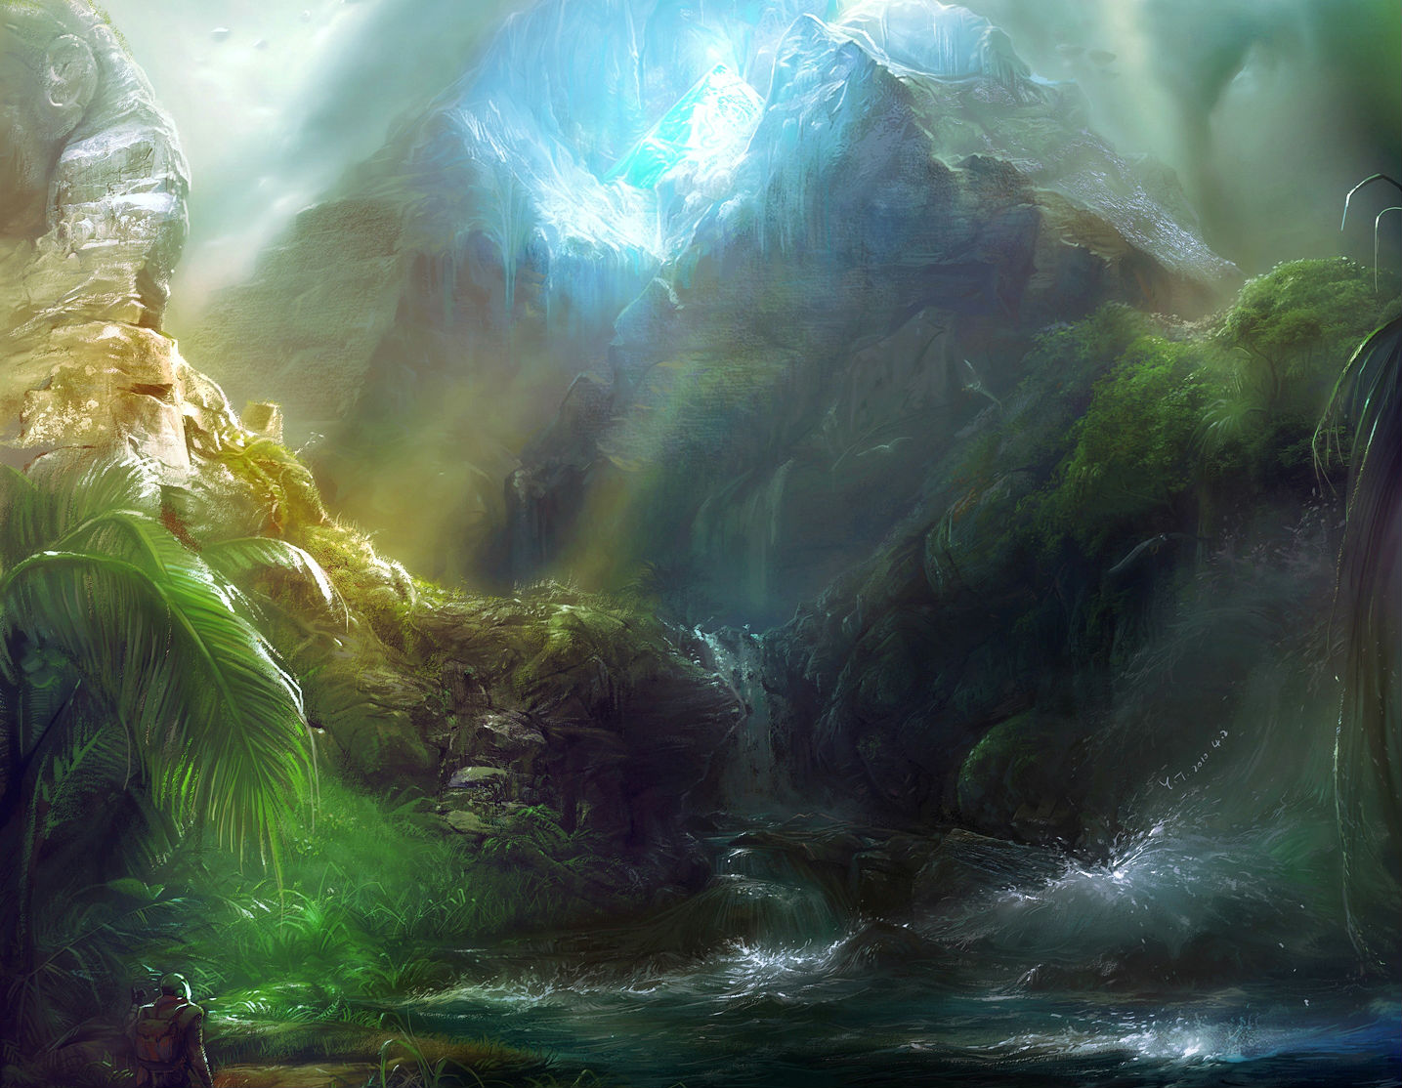
More than 200 languages have been created for cinema/literature
A) True
B) False
Notes:
A

Slide 11
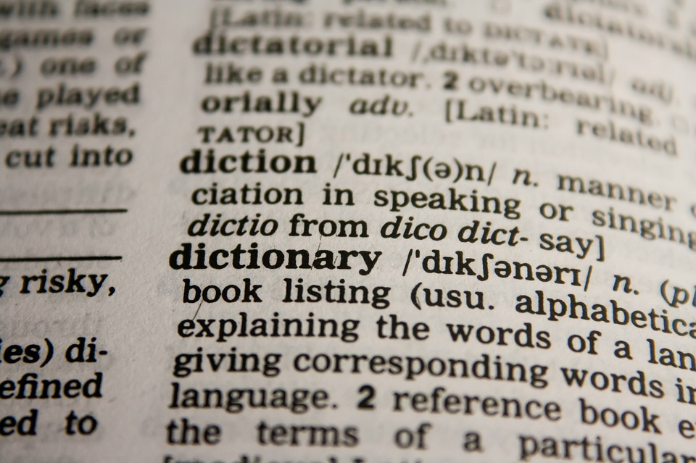
What is a polyglot?
A) Being able to speak 2 languages
B) A teacher of languages
C) Knowing or using several languages
D) A person who speaks only one language
Notes:
C

Slide 12
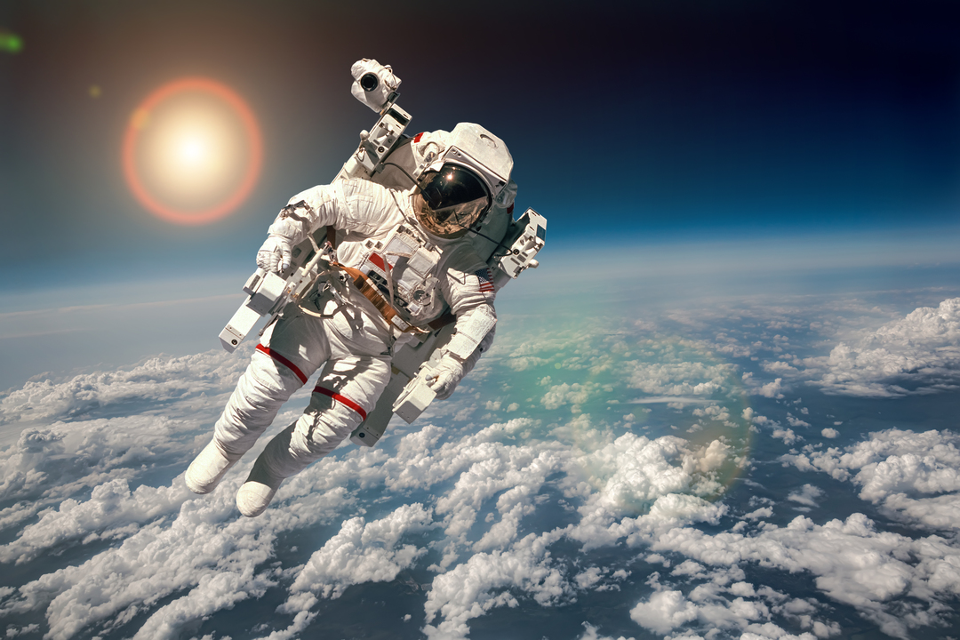
What was the first language spoken in outer space?
A) English
B) Russian
C) Chinese
D) French
Notes:
B

Slide 13
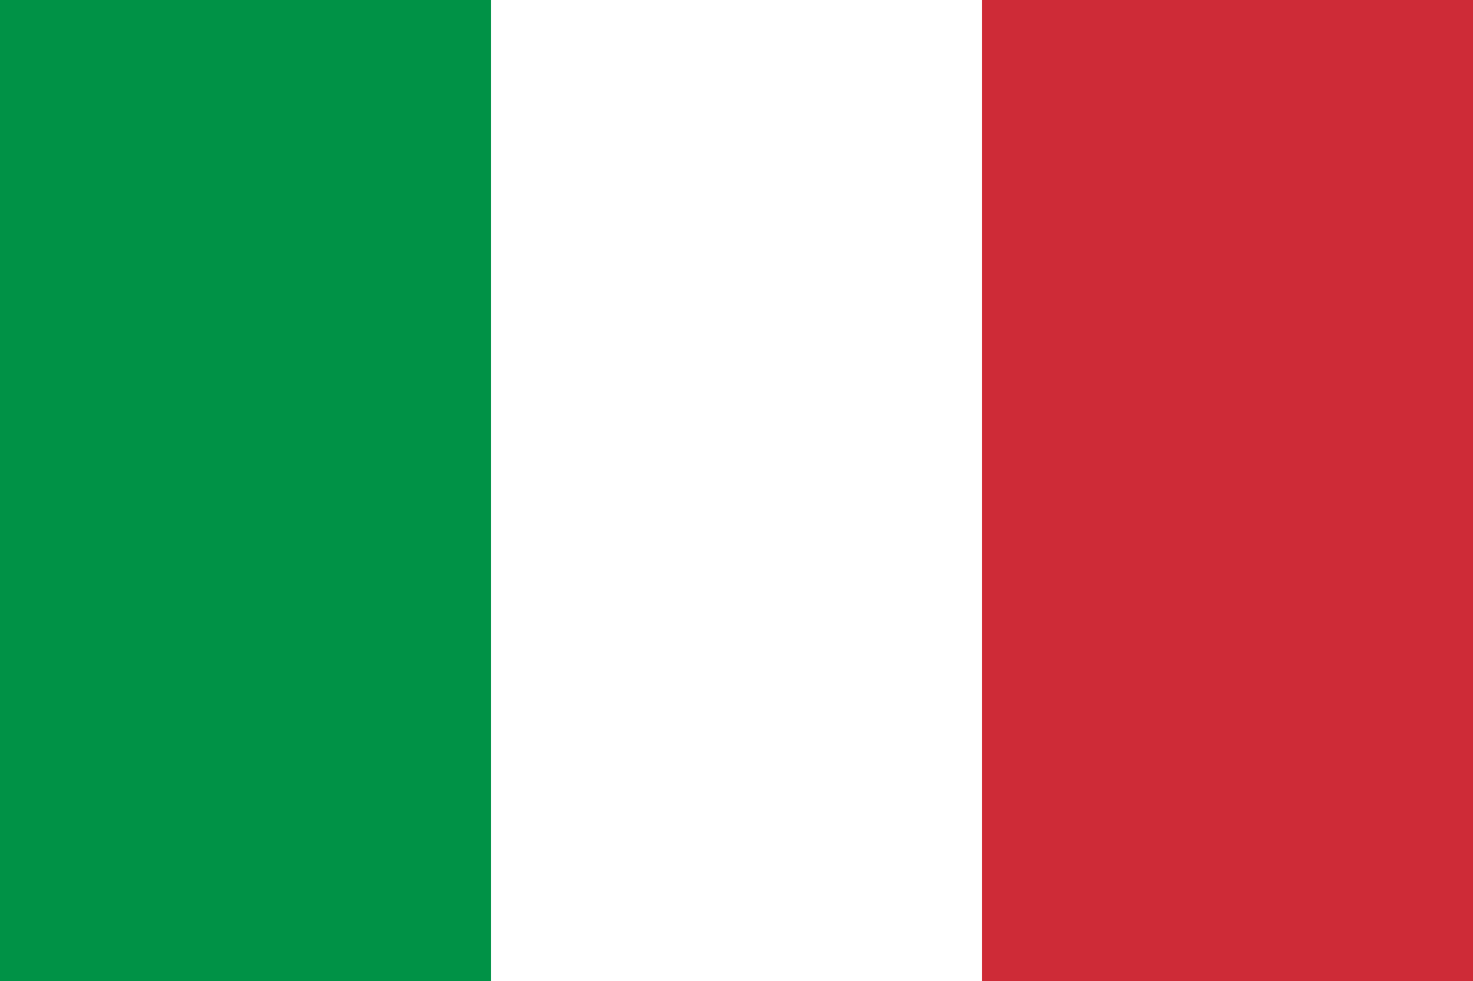
Italian didn’t become the official language of Italy until 2007
A) True
B) False
Notes:
A

Slide 14
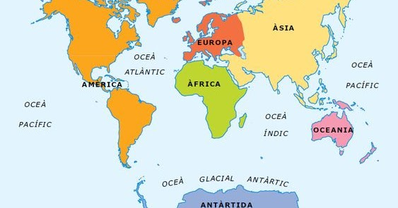
Most of the worlds languages are spoken in…
A) Europe + Asia
B) Asia + Africa
C) South America + Asia
D) Europe + North America
Notes:
B

Slide 15
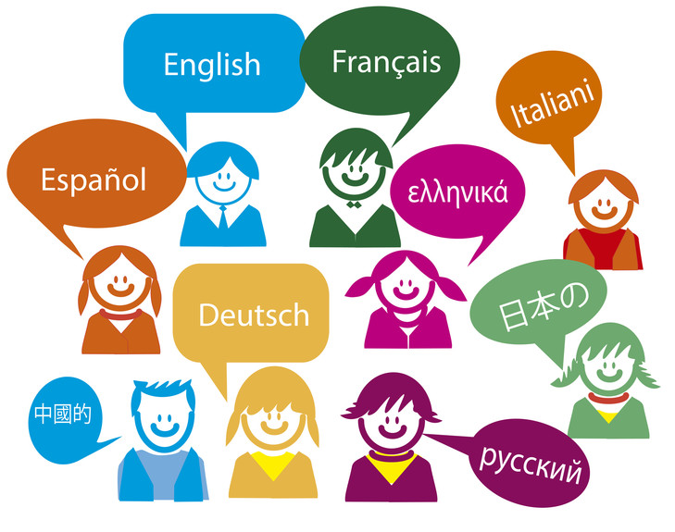
Approximately how many indigenous languages are spoken in Europe?
A) 225
B) 25
C) 2500
D) 12
Notes:
A

Slide 16
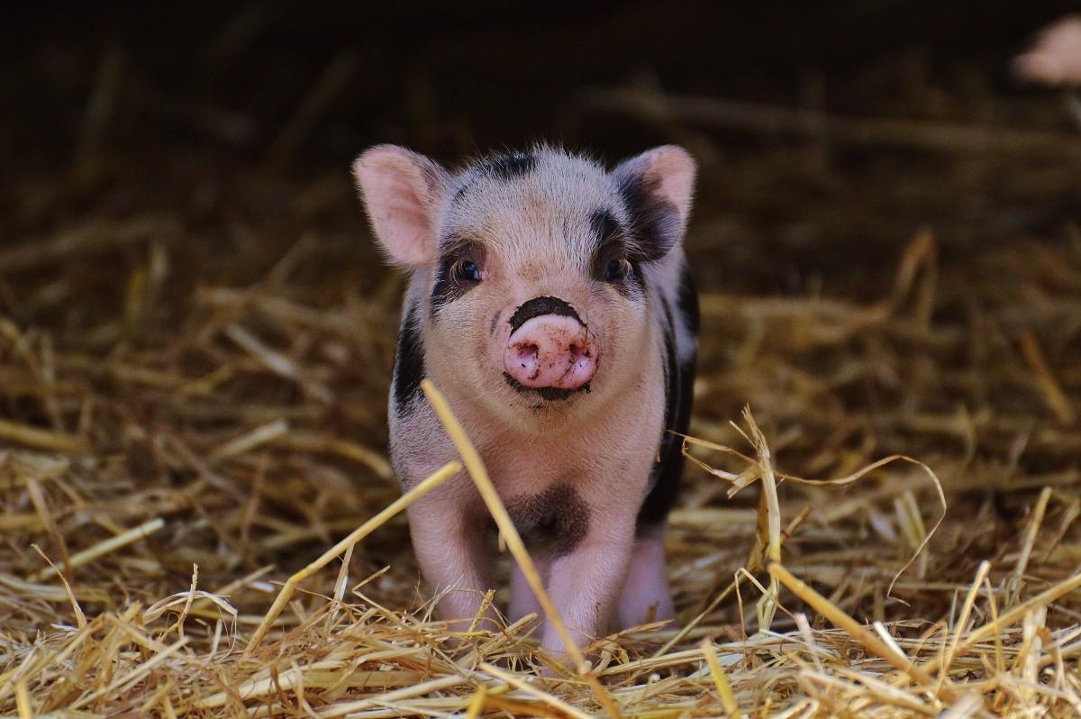
In which European country are there twice as many pigs as people?
A) Wales
B) Denmark
C) Norway
D) England
Notes:
B

Slide 17
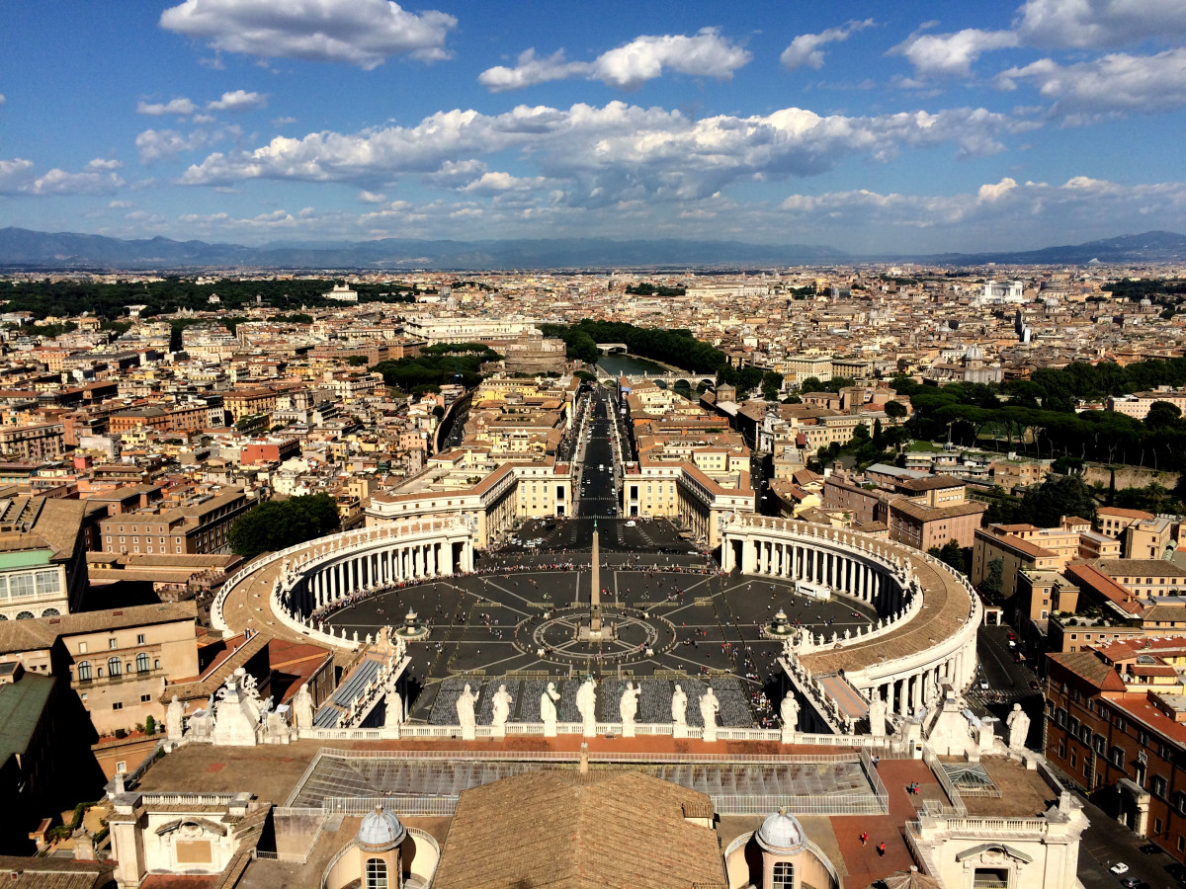
The smallest country in Europe has a population of 805 people
A) True
B) False
Notes:
A – Yes its Vatican city

Slide 18
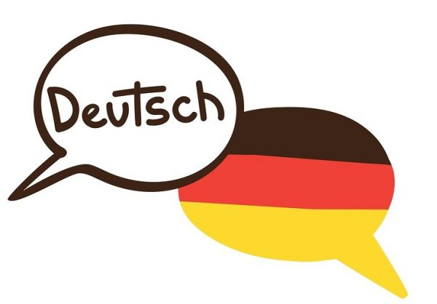
In which of these countries is German not the official language
A) Liechtenstein
B) Switzerland
C) Austria
D) Hungary
Notes:
D

Slide 19
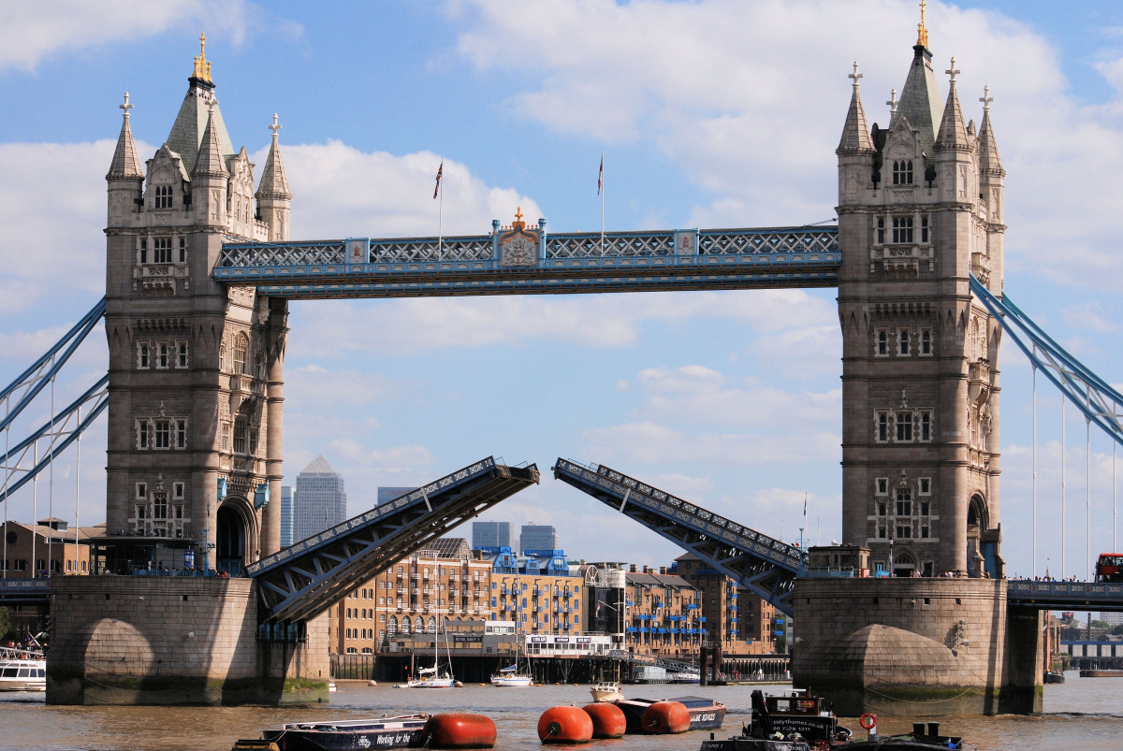
What is the most visited attraction in Europe?
A) Disneyland Paris
B) Louvre
C) Buckingham Palace
D) Roman Colosseum
Notes:
B

Slide 20
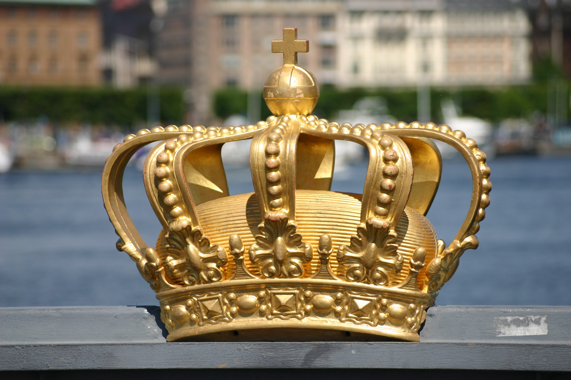
The oldest monarchy in Europe belongs to which country?
A) England
B) France
C) Denmark
D) Russia
Notes:
C

Slide 21
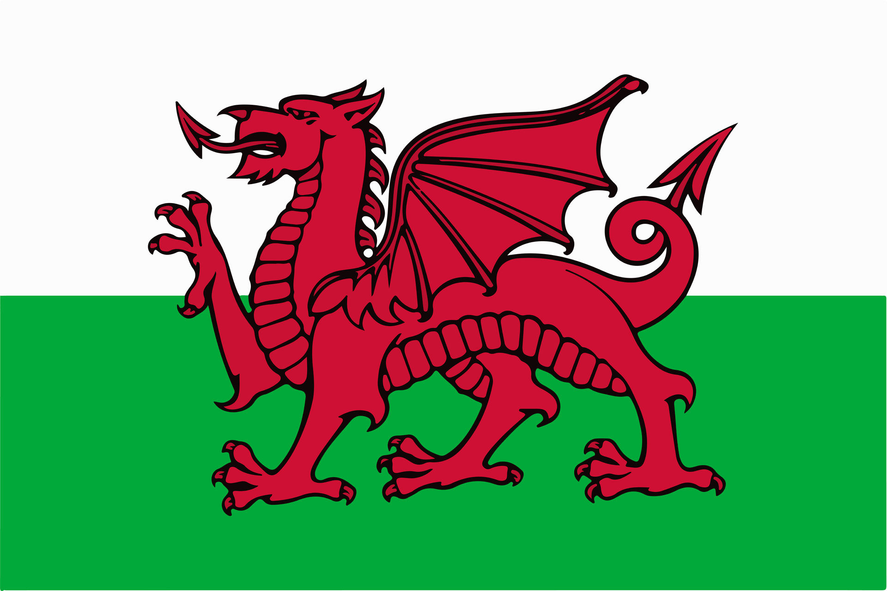
Wales has a town with 57 letters in its name.
A) True
B) False
Notes:
A

Slide 22
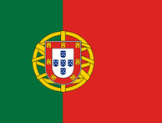
To which country does this flag belong?
A) Spain
B) Luxembourg
C) Morocco
D) Portugal
Notes:
D

Slide 23
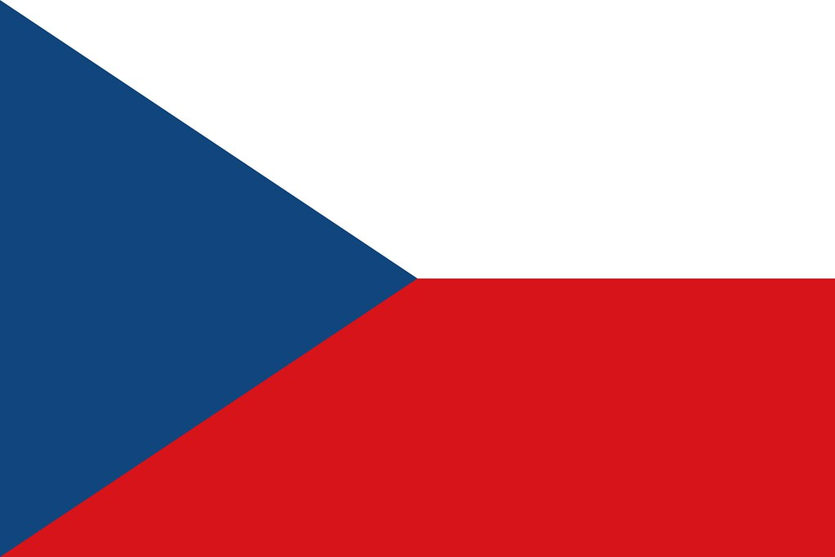
To which country does this flag belong?
A) Holland
B) Moldova
C) Czech Republic
D) Hungary
Notes:
C

Slide 24
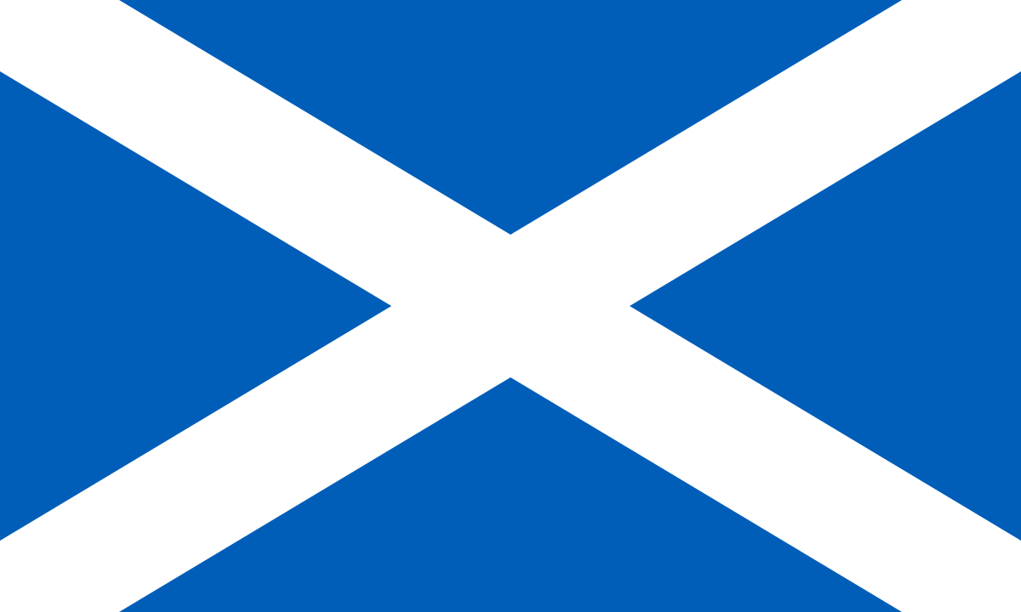
To which country does this flag belong?
A) Scotland
B) Ireland
C) Sweden
D) Iceland
Notes:
A

Slide 25
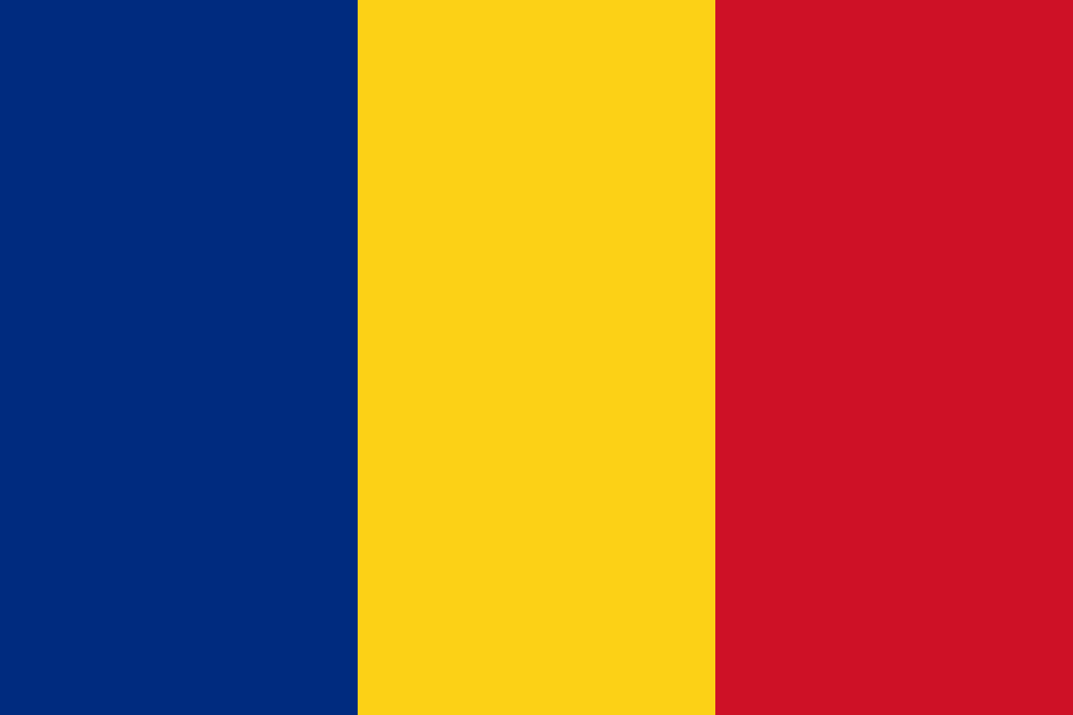
To which country does this flag belong?
A) Bulgaria
B) Lithuania
C) Belgium
D) Romania
Notes:
D

Slide 26
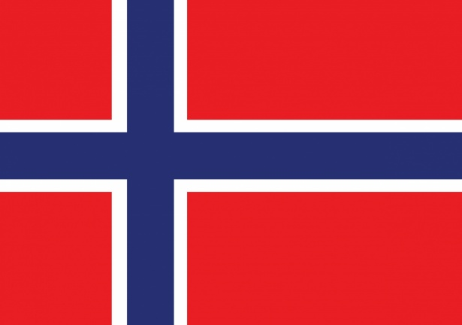
To which country does this flag belong?
A) Serbia
B) Russia
C) Norway
D) Finland
Notes:
C

Slide 27
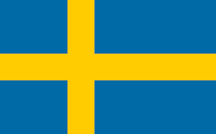
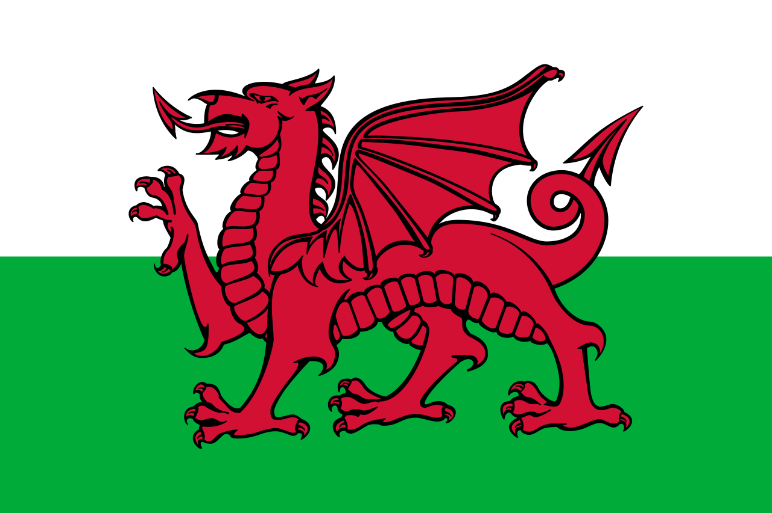
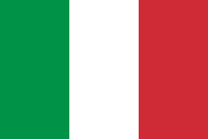
Match the ‘hello’ greeting to the correct language
1) Tere
A) Maltese
2) Bore Da
B) Swedish
3) Buongiorno
C) Welsh
4) Hellow
D) Estonian
5) Hej
E) Italian
Notes:
1 – D 2 – C 3 – E 4 – A 5 - B

Slide 28
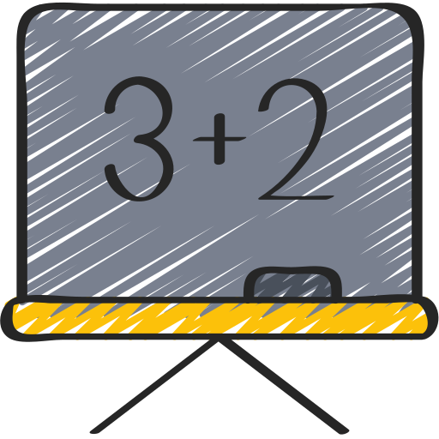
Notes:
Put PowerPoint into present mode. Correct answers will fill in green upon click.

Slide 29
On what date is European Day of Languages celebrated?
A) 26th September
B) 27th September
C) 28th September
C) 29th September
Notes:
A

Slide 30
Less than half of Europe is Bilingual
A) True
B) False
Notes:
B

Slide 31
When was European Day of Languages first celebrated?
A) 2000
B) 2001
C) 2002
D) 2020
Notes:
B

Slide 32
How many member states are there in Europe?
A) 43
B) 44
C) 45
D) 46
Notes:
D

Slide 33
How many different languages are spoken across the world today?
A) 1000 - 2000
B) 3000 - 4000
C) 5000 - 6000
D) 6000 - 7000
Notes:
D

Slide 34
French was the official language of England for over 300 years
A) True
B) False
Notes:
A

Slide 35
What is the oldest European language?
A) French
B) Greek
C) Basque
D) Gaelic
Notes:
C

Slide 36
What does ‘Real’ mean in Real Madrid?
A) Real
B) Regal
C) Winner
D) Royal
Notes:
D

Slide 37
More than 200 languages have been created for cinema/literature
A) True
B) False
Notes:
A

Slide 38
What is a polyglot?
A) Being able to speak 2 languages
B) A teacher of languages
C) Knowing or using several languages
D) A person who speaks only one language
Notes:
C

Slide 39
What was the first language spoken in outer space?
A) English
B) Russian
C) Chinese
D) French
Notes:
B

Slide 40
Italian didn’t become the official language of Italy until 2007
A) True
B) False
Notes:
A

Slide 41
Most of the worlds languages are spoken in…
A) Europe + Asia
B) Asia + Africa
C) South America + Asia
D) Europe + North America
Notes:
B

Slide 42
Approximately how many indigenous languages are spoken in Europe?
A) 225
B) 25
C) 2500
D) 12
Notes:
A

Slide 43
In which European country are there twice as many pigs as people?
A) Wales
B) Denmark
C) Norway
D) England
Notes:
B

Slide 44
The smallest country in Europe has a population of 805 people
A) True
B) False
Notes:
A – Yes its Vatican city

Slide 45
In which of these countries is German not the official language
A) Liechtenstein
B) Switzerland
C) Austria
D) Hungary
Notes:
D

Slide 46
What is the most visited attraction in Europe?
A) Disneyland Paris
B) Louvre
C) Buckingham Palace
D) Roman Colosseum
Notes:
B

Slide 47
The oldest monarchy in Europe belongs to which country?
A) England
B) France
C) Denmark
D) Russia
Notes:
C

Slide 48
Wales has a town with 57 letters in its name.
A) True
B) False
Llanfairpwllgwyngyllgogerychwyrndrobwllllantysiliogogogoch
Notes:
A - Llanfairpwllgwyngyllgogerychwyrndrobwllllantysiliogogogoch

Slide 49
To which country does this flag belong?
A) Spain
B) Luxembourg
C) Morocco
D) Portugal
Notes:
D

Slide 50
To which country does this flag belong?
A) Holland
B) Moldova
C) Czech Republic
D) Hungary
Notes:
C

Slide 51
To which country does this flag belong?
A) Scotland
B) Ireland
C) Sweden
D) Iceland

Slide 52
To which country does this flag belong?
A) Bulgaria
B) Lithuania
C) Belgium
D) Romania
Notes:
D

Slide 53
To which country does this flag belong?
A) Serbia
B) Russia
C) Norway
D) Finland
Notes:
C

Slide 54
Match the ‘hello’ greeting to the correct language
1) Tere
A) Maltese
2) Bore Da
B) Swedish
3) Buongiorno
C) Welsh
4) Hellow
D) Estonian
5) Hej
E) Italian
Notes:
1 – D 2 – C 3 – E 4 – A 5 - B

